Slide 1
Code Smell

Slide 2
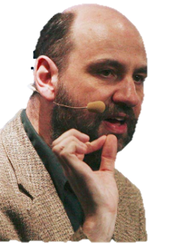
品質不是動作，是一種習慣
Any fool can write code that a computer can understand. Good programmers write code that humans can understand.
- Martin Fowler
Notes:
任何傻瓜都能寫出電腦能懂的程式碼。而只有好的程 式設計師才能寫出人能懂的程式碼 - Martin Fowler.

Slide 3
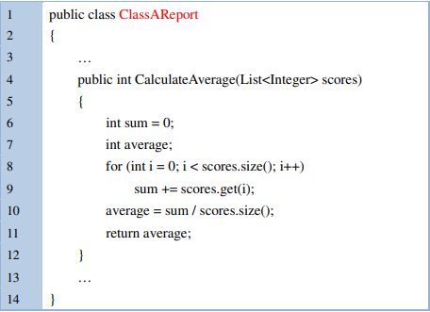
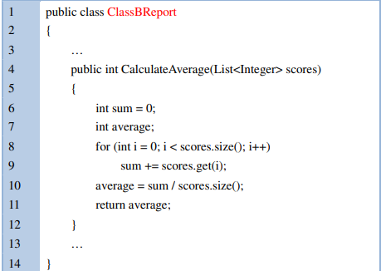
Duplicate Code

Slide 4
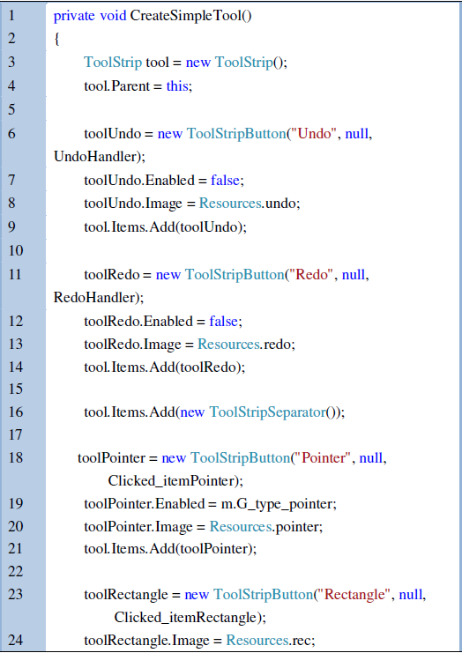
Long Method
Notes:
重寫!

Slide 5
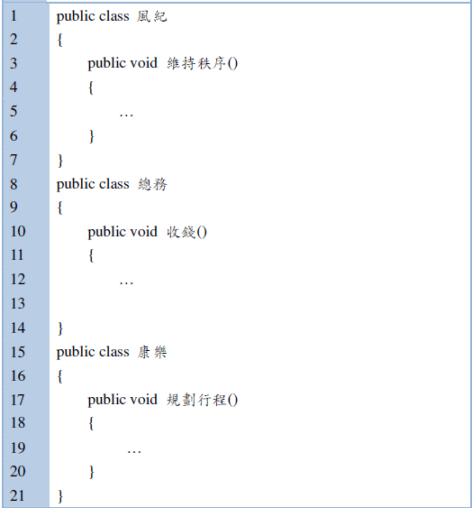
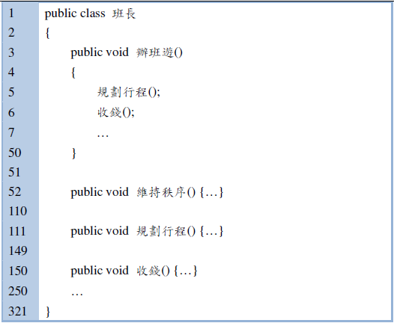
Large Class

Slide 6
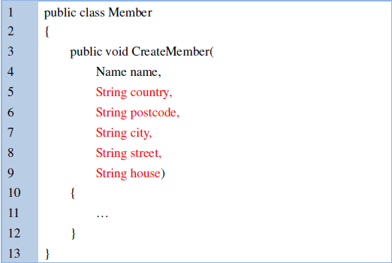
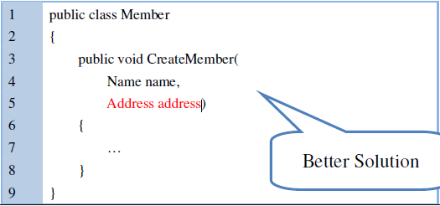
Long Parameter List(Data Clumps)

Slide 7
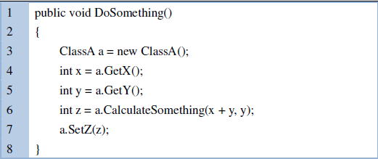
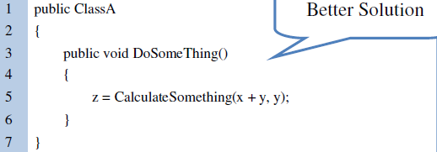
Feature Envy

Slide 8
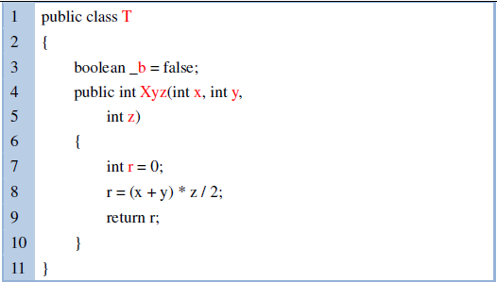
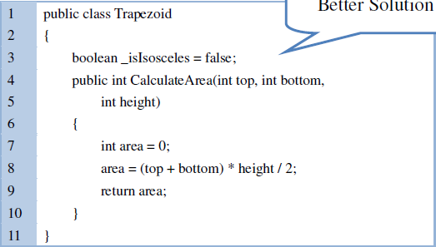
Unsuitable Naming

Slide 9

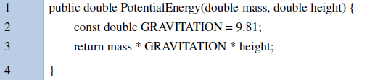
Literal Constants

Slide 10
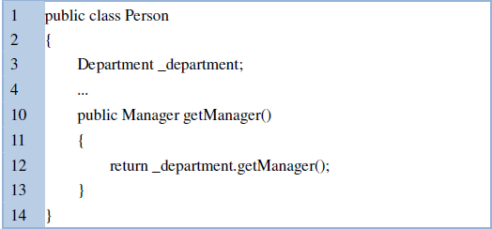
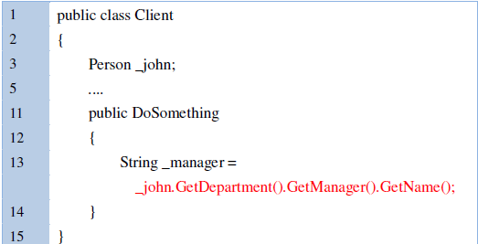
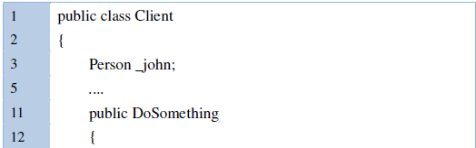

Messages Chains

Slide 11
Temporary Field
1 | double temp = 2 * (_height + _width);
2 | System.out.println(temp);
3 | temp = _height * _width;
4 | System.out.println(temp);
1 | final double perimeter = 2 * (_height + _width);
2 | System.out.println(perimeter);
3 | final double area = _height * _width;
4 | System.out.println(area);

